Slide 1
A
M
B
I
G
U
O
U
S
SCIENCE
And the Imag/in/ing of the Real
Curtis Newbold – April 4, 2011

Slide 2

AMBIGUOUSSCIENCE
“The process of visualization [is not] an effort to produce reality as it presents itself to the scientist, since science is not about copying nature and culture, but about revealing it.”
visualization
produce reality
science
nature
culture
revealing
Ambiguity
“Mimesis without expression is virtually impossible.”
Mimesis
expression
“The human mind…seems eager to fill in the gaps and to make us see what we want to see”
human mind
gaps
make us see
-Luc Pauwels, Visual Cultures of Science
2

Slide 3

Am[BIG]you-ity
AMBIGUOUSSCIENCE
visual
Definitions
beauty
Aspects
Causes
The study of beauty “is key to unlocking bewildering…mysteries and secrets”
“Rigorous scientific models of how biological processes occur”
“Our understanding is just exploding”
3
Notes:
Term: “Beauty”

Slide 4
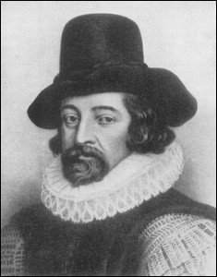
Am[BIG]you-ity
AMBIGUOUSSCIENCE
visual
Rhetoric & Language
Definitions
beauty
confusion
“Obstruct the understanding”
“Throw all into confusion”
Aspects
rhetorical
Causes
incommensurability
4
Notes:
Definitions: Confusion Aspects: rhetorical Causes: Incommensurability

Slide 5

Am[BIG]you-ity
AMBIGUOUSSCIENCE
visual
Definitions
beauty
confusion
seductive details
Aspects
rhetorical
Causes
incommensurability
5
Notes:
Definitions: seductive details Aspects: Causes:

Slide 6

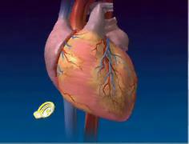
Am[BIG]you-ity
AMBIGUOUSSCIENCE
visual
Definitions
beauty
confusion
seductive details
Aspects
rhetorical
subjunctive
Causes
incommensurability
6
Notes:
Definitions: abstraction Aspects: subjunctive Causes: mimesis is imperfect

Slide 7
Am[BIG]you-ity
AMBIGUOUSSCIENCE
visual
Definitions
REAL
A
beauty
confusion
IMAGE
seductive details
M
IMESIS
multiplicity of meaning
ABSTRACT
B
=
SIMULATION
I
MEANING
G
MULTIPLICITY
U
Aspects
REPRESENTATION
D STORTED
I
rhetorical
subjunctive
AESTHETIC
T
CURIOSITY
Y
Causes
incommensurability
7
Notes:
Definitions: distortion; multiple meanings

Slide 8
Am[BIG]you-ity
AMBIGUOUSSCIENCE
visual
Definitions
beauty
confusion
seductive details
multiplicity of meaning
Communication technologies “restructure consciousness, affecting [our] presence to the world and to [ourselves]and creating new interior distances within the psyche.”
-Walter Ong
Aspects
rhetorical
subjunctive
separates from the real
Causes
incommensurability
8
Notes:
Definitions: simulacrum Aspects: separates from the real

Slide 9
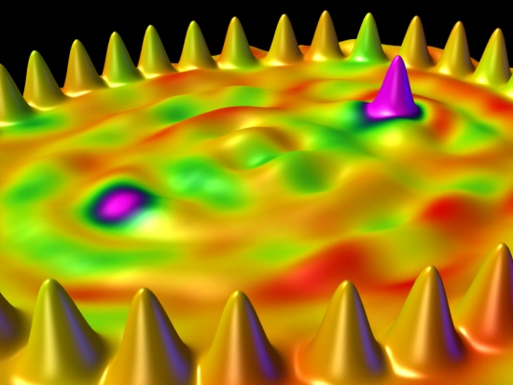
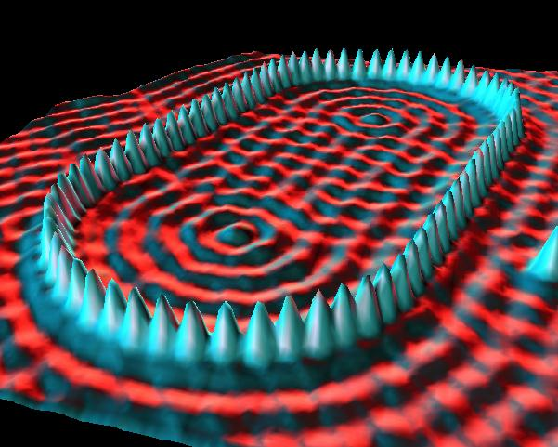
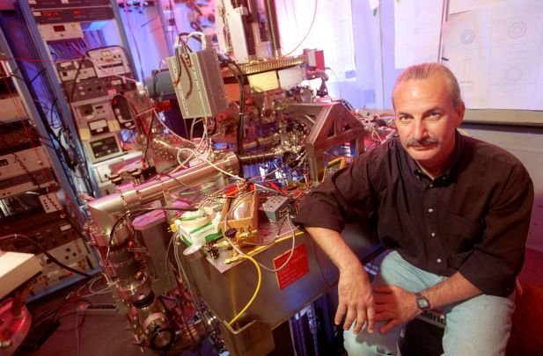
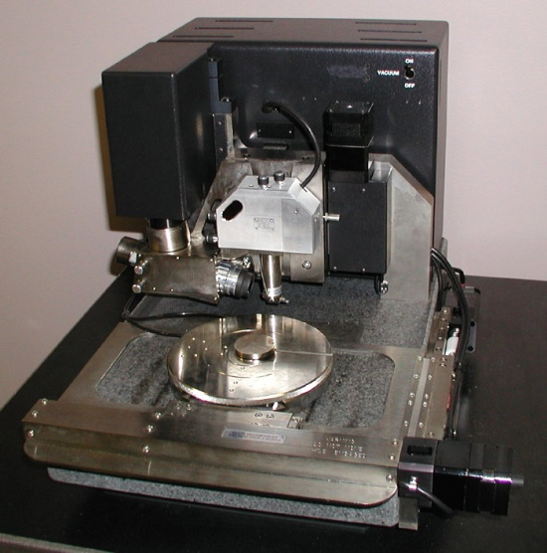
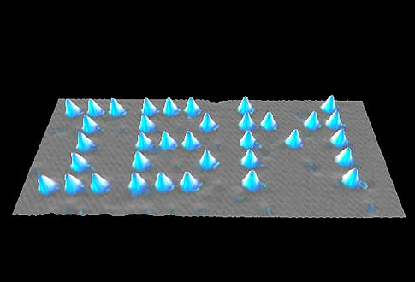
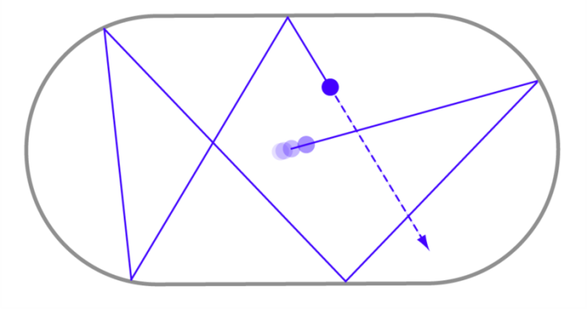
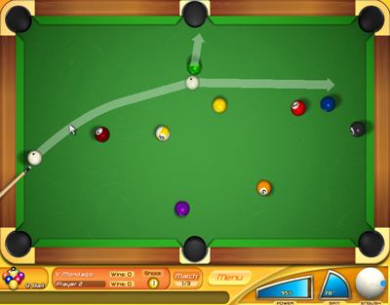
Am[BIG]you-ity
AMBIGUOUSSCIENCE
visual
Definitions
beauty
confusion
seductive details
multiplicity of meaning
Quantum Mirage
Quantum Corral
Aspects
rhetorical
subjunctive
separates from the real
Causes
Dynamical Billiards
incommensurability
9

Slide 10
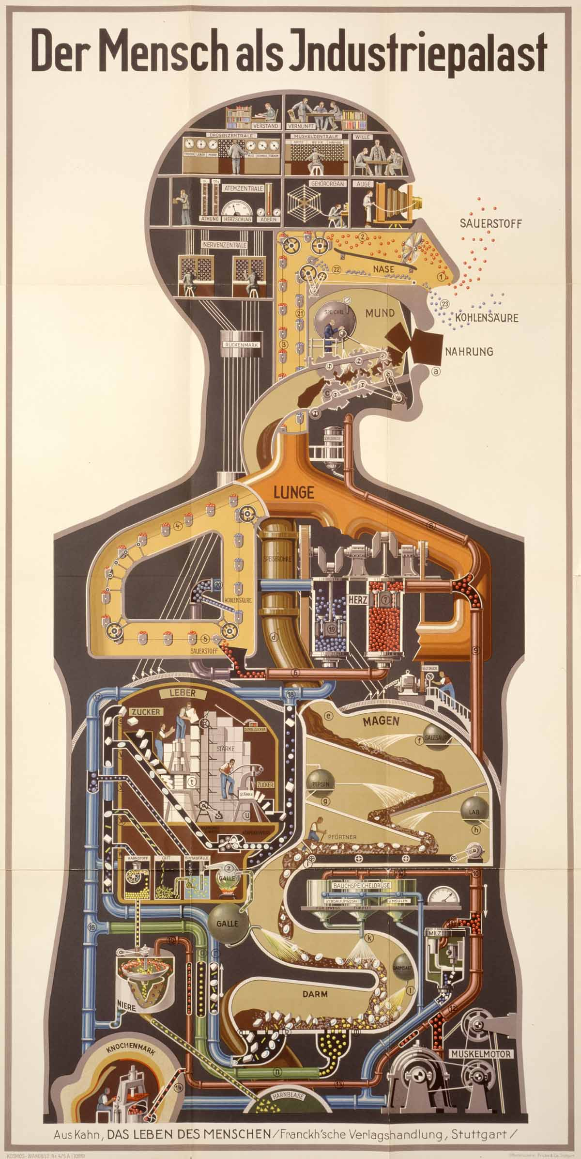


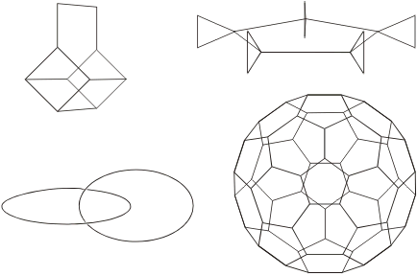
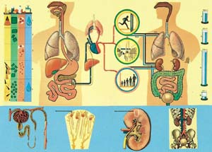


Am[BIG]you-ity
Am[BIG]you-ity
AMBIGUOUSSCIENCE
visual
Definitions
Definitions
Basket (basketane)
Rotor (rotane)
beauty
confusion
seductive details
multiplicity of meaning
Aspects
Aspects
rhetorical
“Liver as Storehouse”
subjunctive
Chain(catenane)
Wheel (roxatane)
separates from the real
Causes
Causes
incommensurability
“Man as Industrial Palace”
thought is metaphorical
10
Notes:
Causes: language and thought are metaphorical

Slide 11
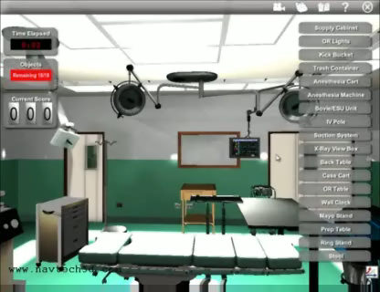
Am[BIG]you-ity
Am[BIG]you-ity
Am[BIG]you-ity
AMBIGUOUSSCIENCE
visual
Definitions
Definitions
Definitions
beauty
confusion
seductive details
multiplicity of meaning
Aspects
Aspects
Aspects
rhetorical
subjunctive
separates from the real
promotes action
Causes
Causes
Causes
incommensurability
thought is metaphorical
11
Notes:
Aspects: invokes opportunity for action

Slide 12
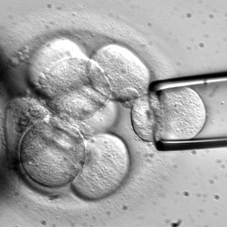

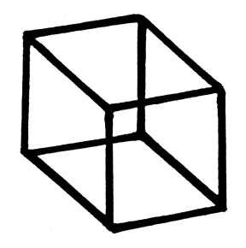

Am[BIG]you-ity
Am[BIG]you-ity
Am[BIG]you-ity
AMBIGUOUSSCIENCE
visual
Stem Cell Harvest
Definitions
Definitions
Definitions
beauty
confusion
seductive details
multiplicity of meaning
Aspects
Aspects
The photograph paradox can…be seen as the co-existence of two messages, the one without a code (the photographic analogue), the other with a code (the ‘art’, or the treatment, or the ‘writing’, or the rhetoric, of the photograph); structurally, the paradox is clearly not the collusion of a denoted message and a connoted message…, it is that here the connoted (or coded) message develops on the basis of a message without a code. This structural paradox coincides with an ethical paradox: when one wants to be ‘neutral’, ‘objective,’ one strives to copy reality meticulously, as though the analogical were a factor of resistance against the investment of values; how then can the photograph be at once ‘objective’ and ‘invested’, natural, and cultural?
-Roland Barthes, “The Photographic Message
“Even efficient knowledge may be rejected because of the way its acquisition disturbs important social values.”
-Paul Feyerabend, Farewell to Reason
Aspects
rhetorical
subjunctive
separates from the real
promotes action
Causes
Causes
Causes
incommensurability
thought is metaphorical
culture in every image
12
Notes:
Definitions: multistable Causes: Culture in every image

Slide 13
Am[BIG]you-ity
Am[BIG]you-ity
Am[BIG]you-ity
Am[BIG]you-ity
AMBIGUOUSSCIENCE
visual
Definitions
Definitions
Definitions
Definitions
beauty
confusion
seductive details
multiplicity of meaning
Visual ambiguity is the degree to which multiple interpretations, removal from the authenticity of the referent, or possibility for action and choice is present.
Aspects
Aspects
Aspects
Aspects
rhetorical
subjunctive
separates from the real
promotes action
Causes
Causes
Causes
Causes
incommensurability
thought is metaphorical
culture in every image
13

Slide 14
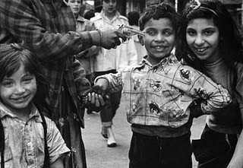
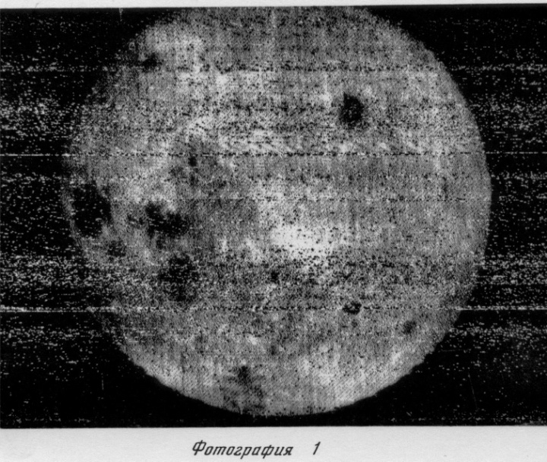

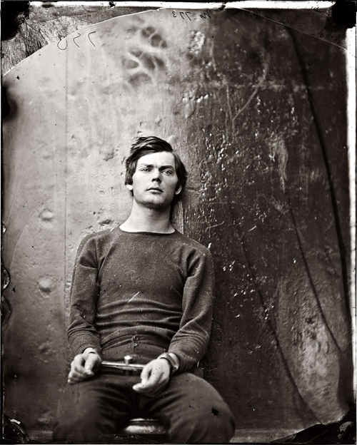
Am[BIG]you-ity
Am[BIG]you-ity
Am[BIG]you-ity
Am[BIG]you-ity
AMBIGUOUSSCIENCE
visual
Punctum
Definitions
Definitions
Definitions
Definitions
beauty
confusion
seductive details
multiplicity of meaning
punctum
Modality
modality
noise
Noise
Aspects
Aspects
Aspects
Aspects
rhetorical
subjunctive
separates from the real
promotes action
Causes
Causes
Causes
Causes
incommensurability
thought is metaphorical
culture in every image
14

Slide 15
Am[BIG]you-ity
Am[BIG]you-ity
Am[BIG]you-ity
Am[BIG]you-ity
AMBIGUOUSSCIENCE
visual
Definitions
Definitions
Definitions
Definitions
beauty
confusion
seductive details
multiplicity of meaning
punctum
modality
“There is more entropy in the real world than there is in your computer. That’s just the way it is.”
-Sherry Turkle, Simulation and Its Discontents
noise
Aspects
Aspects
Aspects
Aspects
rhetorical
subjunctive
separates from the real
promotes action
Causes
Causes
Causes
Causes
incommensurability
thought is metaphorical
culture in every image
15
Notes:
Causes: Senses deceive us

Slide 16
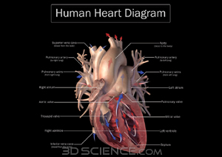
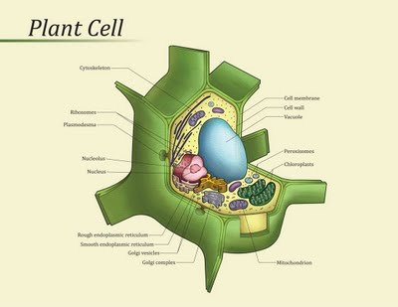
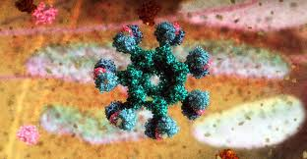
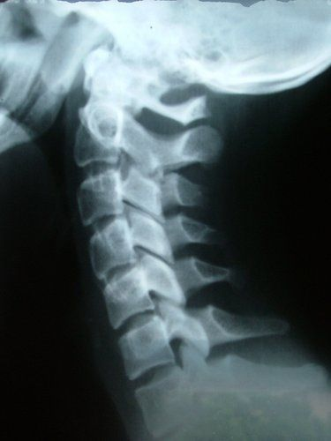
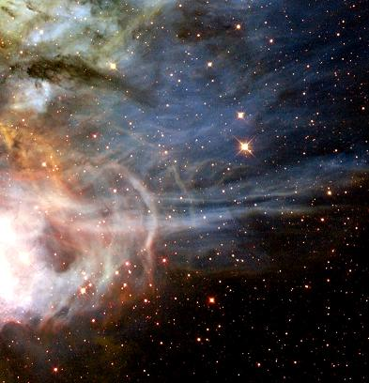

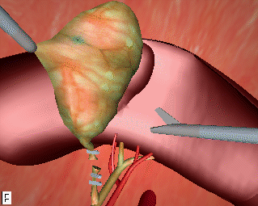
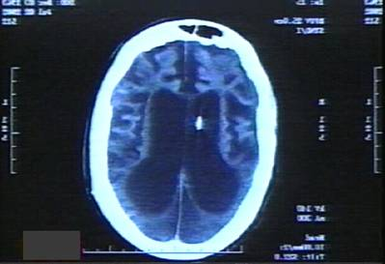

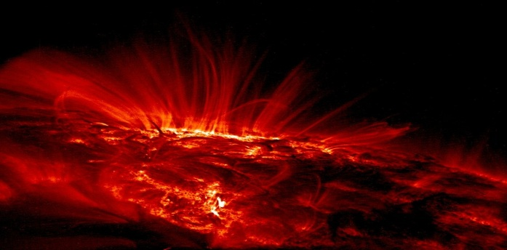
Am[BIG]you-ity
Am[BIG]you-ity
Am[BIG]you-ity
Am[BIG]you-ity
AMBIGUOUSSCIENCE
visual
Definitions
Definitions
Definitions
Definitions
beauty
confusion
seductive details
multiplicity of meaning
punctum
modality
Imaging
noise
Imagining
SCIENCE
Aspects
Aspects
Aspects
Aspects
rhetorical
subjunctive
separates from the real
promotes action
Causes
Causes
Causes
Causes
incommensurability
thought is metaphorical
culture in every image
16

